Slide 1
RouteMatch Software
innovative passenger transportation technologies

Slide 2
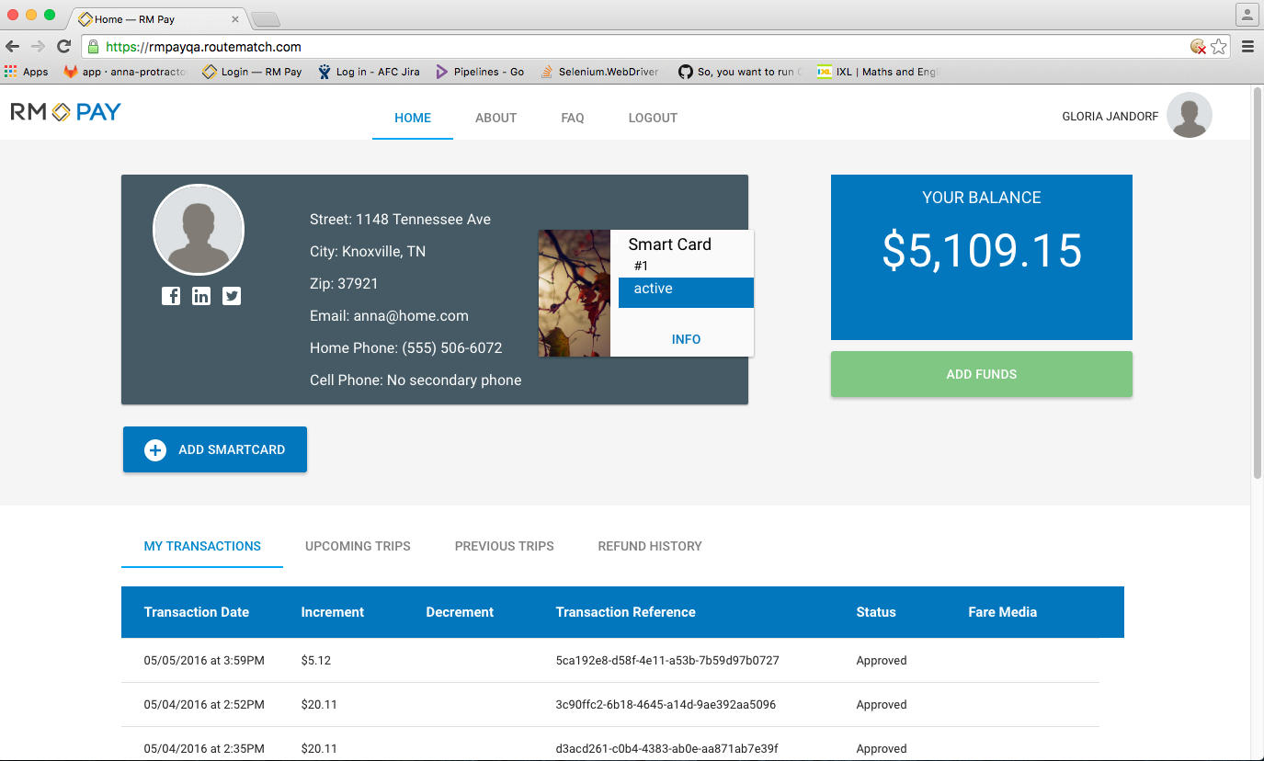
Web application–customer’s home page

Slide 3
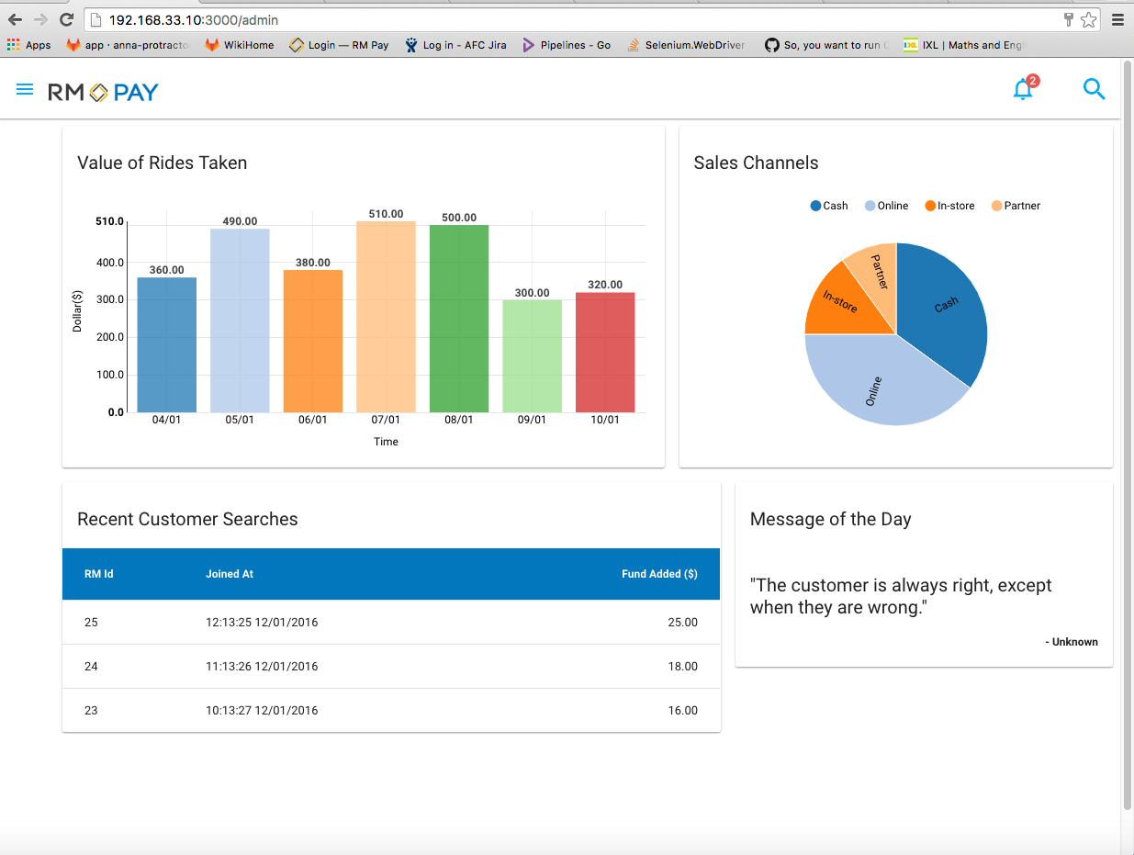
Agency home page

Slide 4
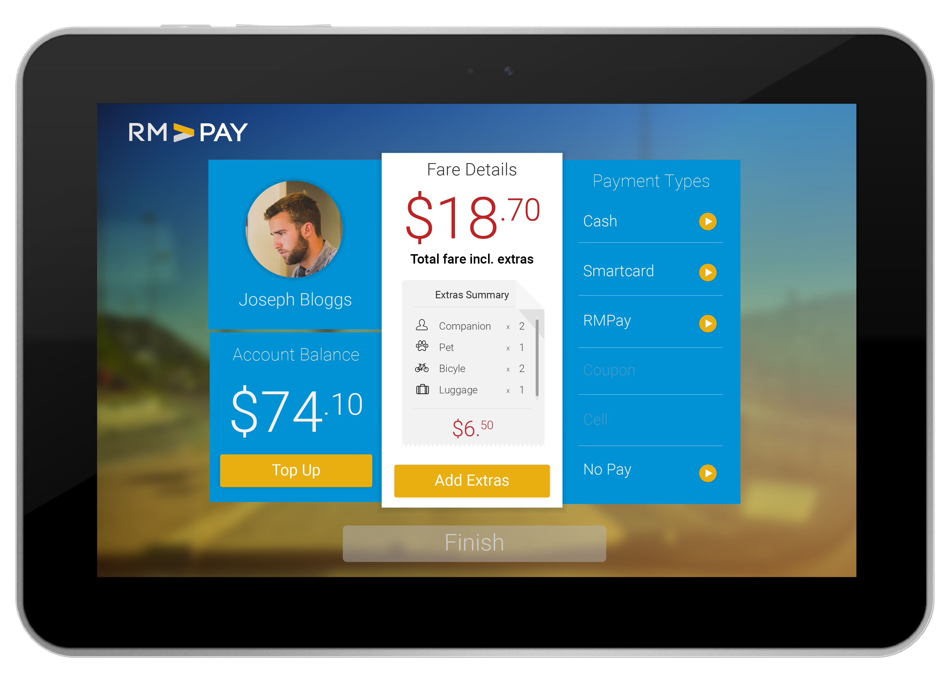
Mobile app for bus drivers

Slide 5
System model
AngularJS
Dockerised services
(node.js – express)
Mongo DB
Android (Java)
REST

Slide 6
Agile methodology (Scrum)
- Small Sprint iterations
- Individuals and interactions
- Working software
- Responding to change
- Business value

Slide 7
Agile testing pyramid

Slide 8
Continuous Integration
Single repo
Automate build
Self-testing
Integration machine
Fast build
Visible

Slide 9
Docker containers
Docker build/pull
Docker remove
Docker remove
Docker stop
Docker run
container
Isolated
Lightweight
Open
Shippable
Run service/app/command
Docker
compose

Slide 10
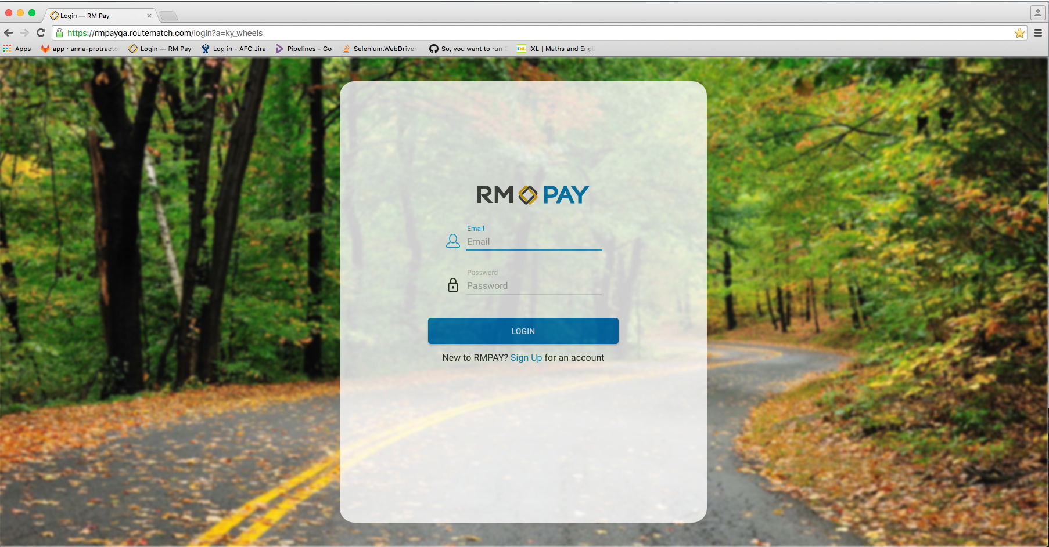
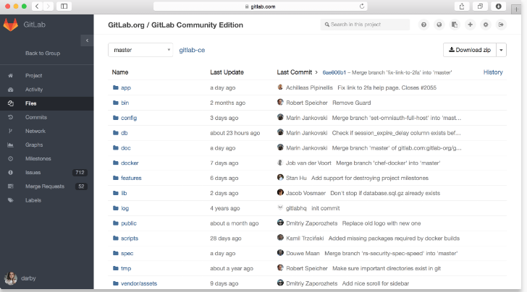
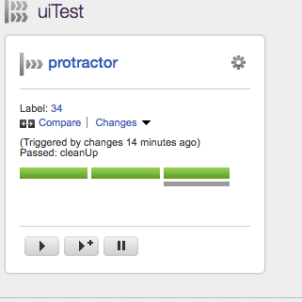
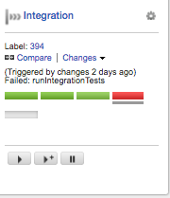

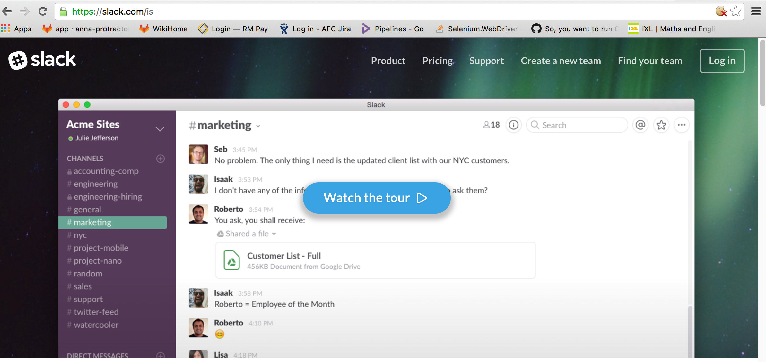
Continuous Integration: UI tests
Git Push
New version of app
New Pipeline Run
Running first stage
Starting 2nd stage
1st stage succesfull
Third stage:
remove docker
GitLab
Success
Failure

Slide 11
GoCD model
Server
Environment
Pipelines
Agent: IP: XX.XX.XX.XXX

Slide 12
GoCD – Pipelines, Agents, Environments

Slide 13
GoCD – Pipelines, Agents, Environments

Slide 14
Running functional tests
(Create session)
HTTP: www….
POST /wd/hub/ session
200 POST /wd/hub/ session {“sessionId” ;”123”}
WebDriver
Browser-like actions

Slide 15
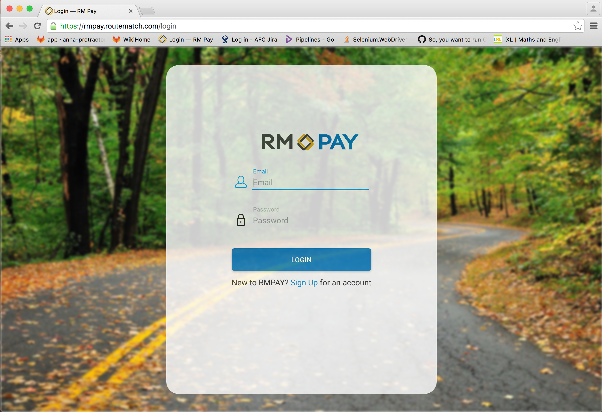
Test:Login add funds: Expect title Login RmPay

Slide 16
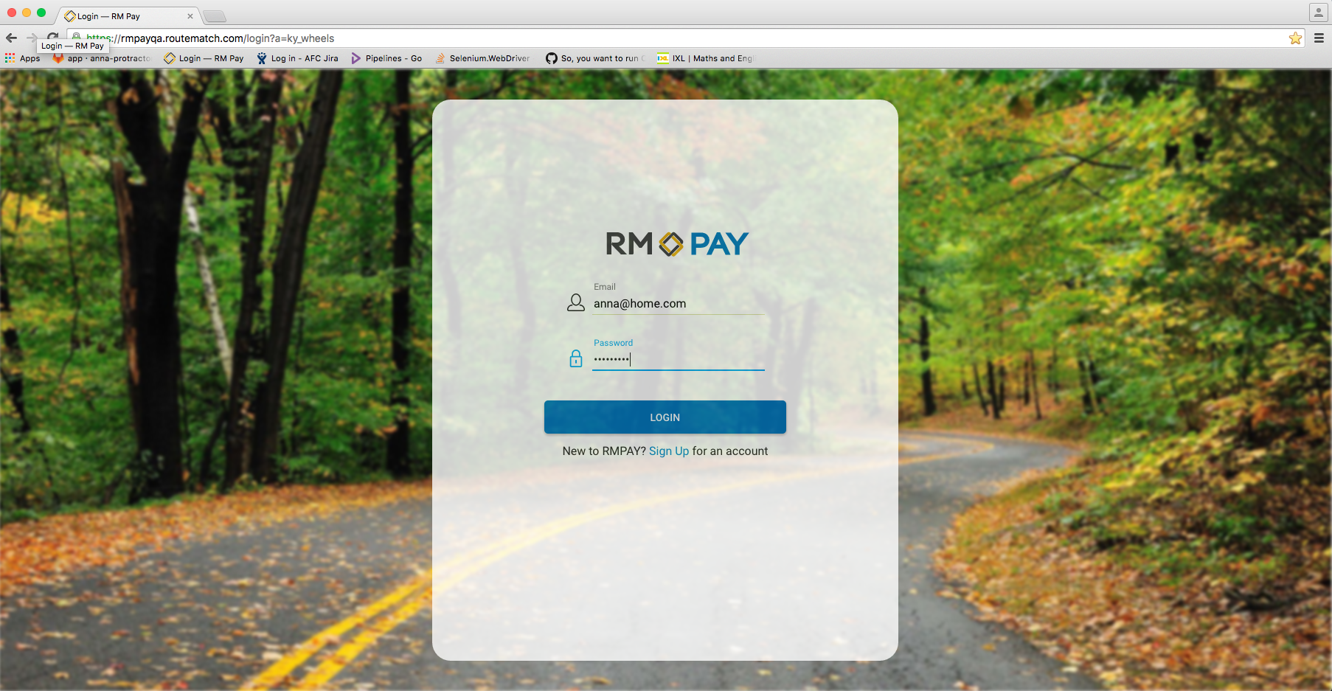
Test: Login add funds: Fill in login form

Slide 17
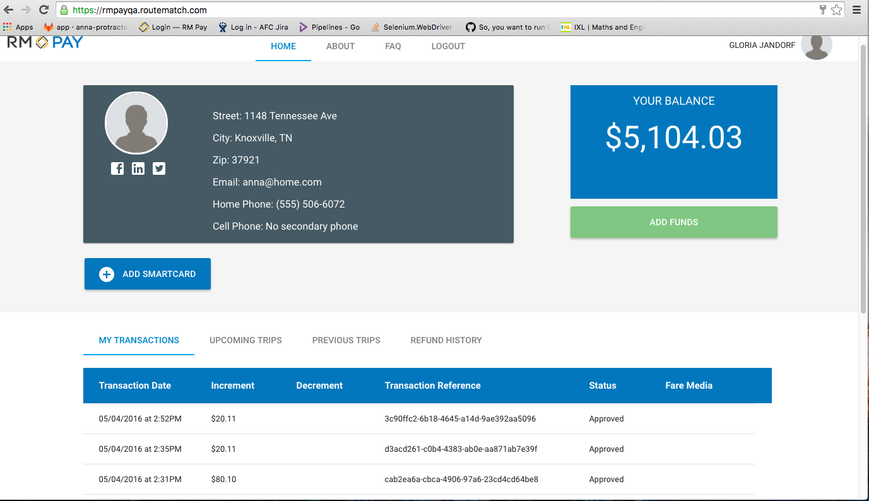
Test: Login add funds: Expect name GLORIA JANDORF

Slide 18
Test: Login add funds: Take the balance amount
Convert string to a number, remove $ and ‘,’
Add payment amount
Convert back to string, add $
Save the final string as expected value

Slide 19
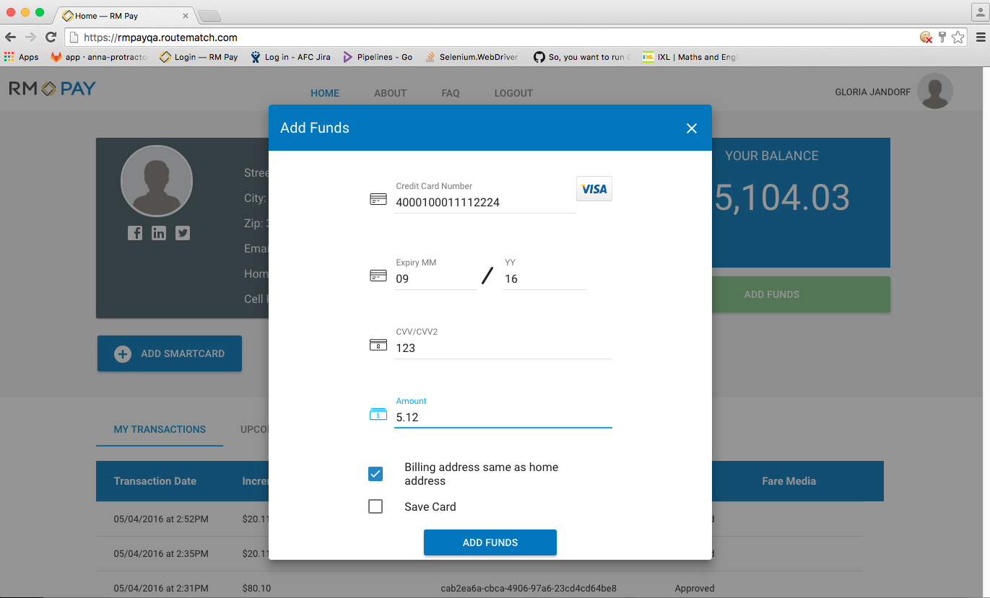
Test: Login add funds: Add funds $5.12 from new card

Slide 20
Test: Login add funds: Check: balance amount is balance expected

Slide 21
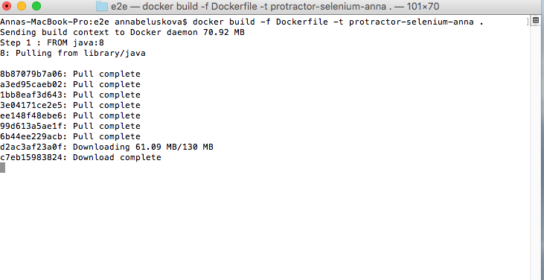
Docker build

Slide 22
GoCD Pipelines

Slide 23
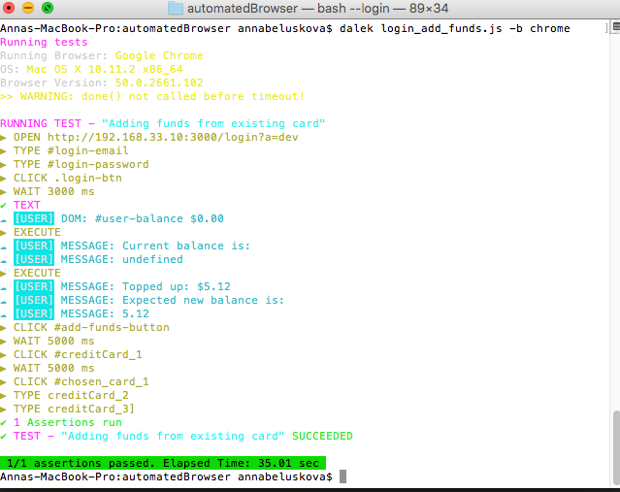
Console output DalekJS

Slide 24
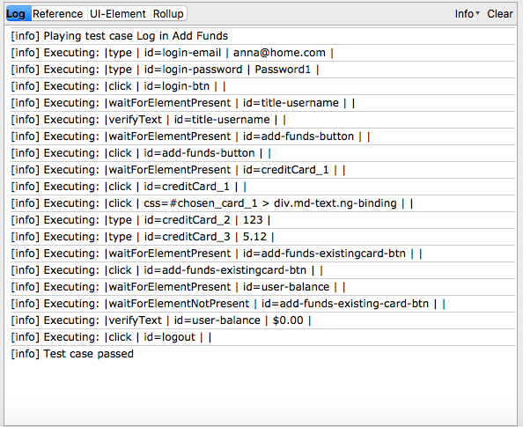
Console output Selenium IDE

Slide 25
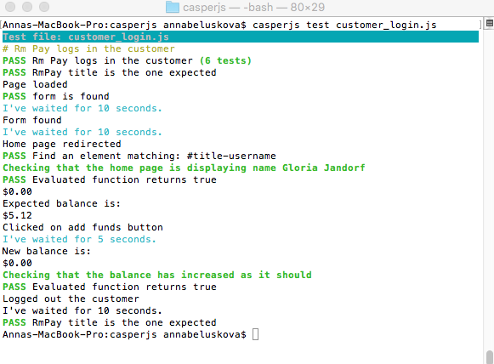
Console output CasperJS

Slide 26
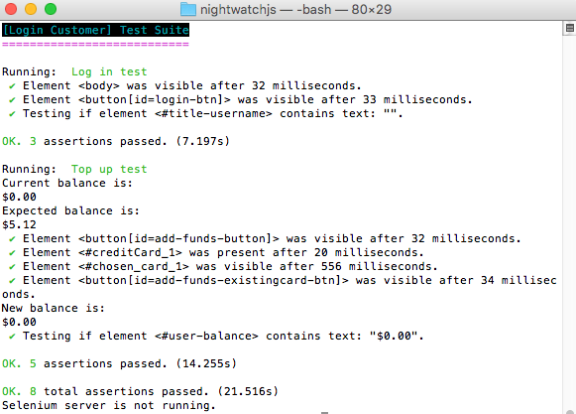
Console output NightwatchJS

Slide 27
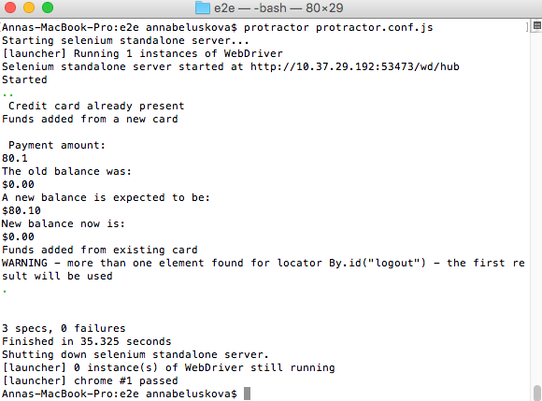
Console output Protractor

Slide 28
Comparison Results
 | Selenium IDE | DalekJS | CasperJS | Protractor | NightwatchJS
Installation | **** | ***** | ***** | **** | *****
Guidance docs | * | **** | **** | ***** | *
Config file | **** | ** | * | **** | *****
Writing scripts | * | **** | * | ***** | ****
Element locators | **** | * | *** | ***** | *****
Running scripts | ** | * | ** | ***** | ***
Test outputs | * | *** | *** | *** | *****
API variety | **** | ** | **** | **** | *****
Browsers | ** | *** | * | *** | ***
Docker image | N/A | ***** | ***** | **** | ***
Docker container | N/A | ***** | ***** | **** | N/A
Pipeline setup | N/A | ***** | ***** | **** | N/A
Pipeline outcome | N/A | * | * | **** | N/A

Slide 29
Final choice

